Slide 1
Print Room Simulator
Blue Team

Slide 2
Agenda
Goals
Solution
Demo
Challenges

Slide 3
Goals
Implement the print room simulator
DSL modeling for components and statemachines
Implementing the behavior using python scripts in the Blender environment
Competitive elements
Component structure
System structure
Green button implementation

Slide 4
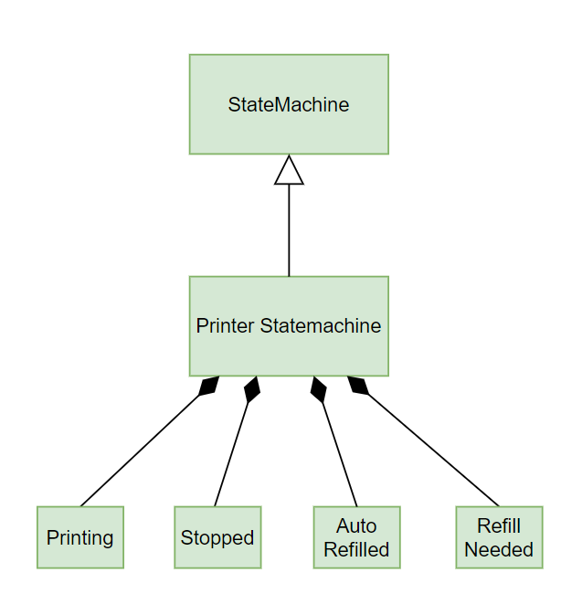
Solution

Slide 5
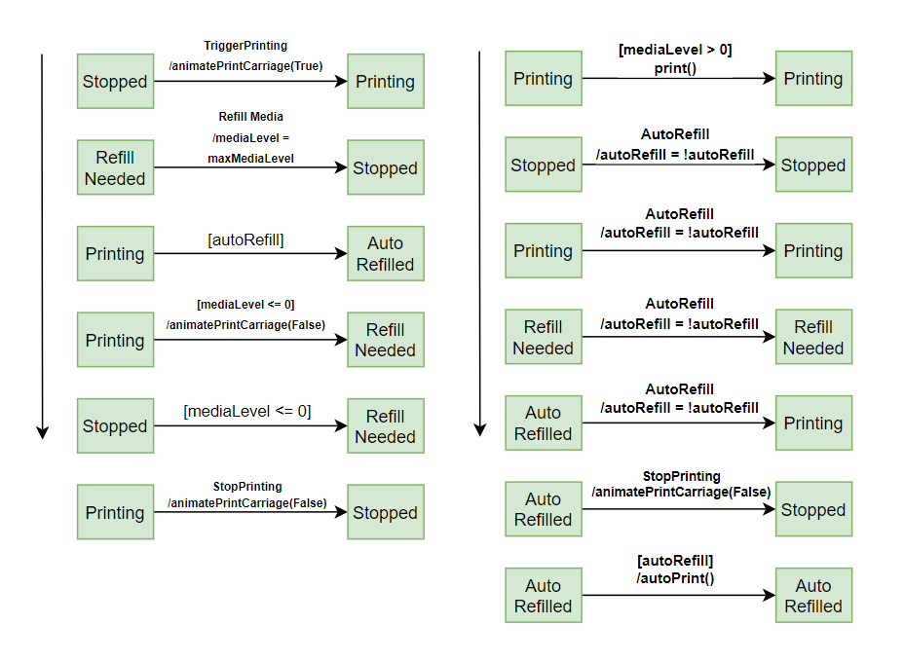
Solution

Slide 6
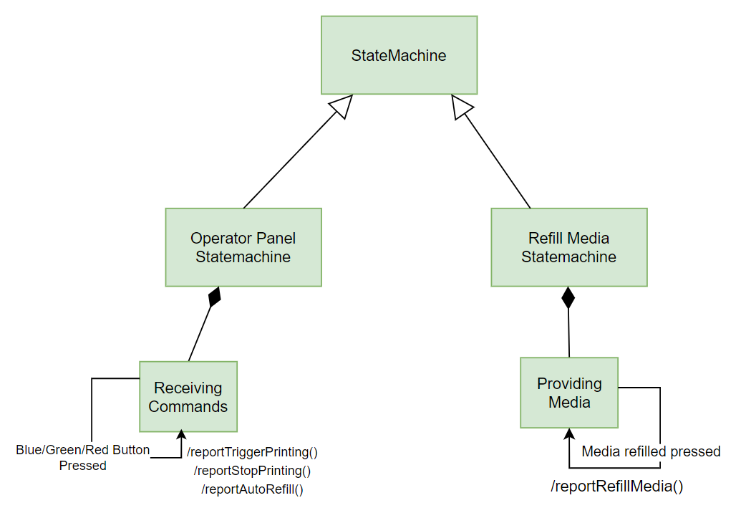
Solution

Slide 7
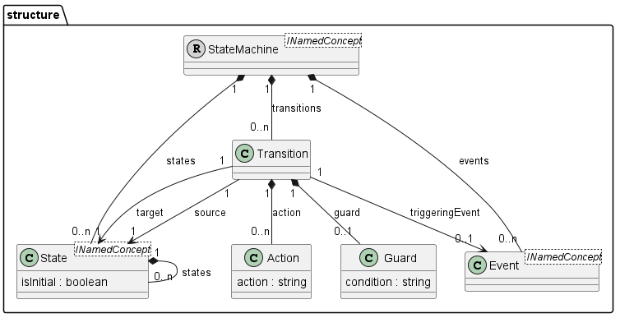
Solution: State Machine Language

Slide 8
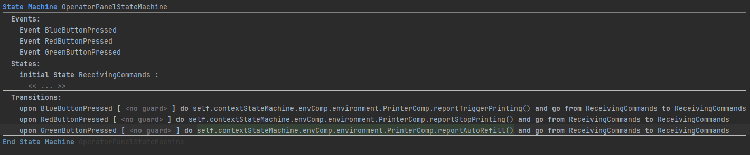
Solution: State Machine Language

Slide 9
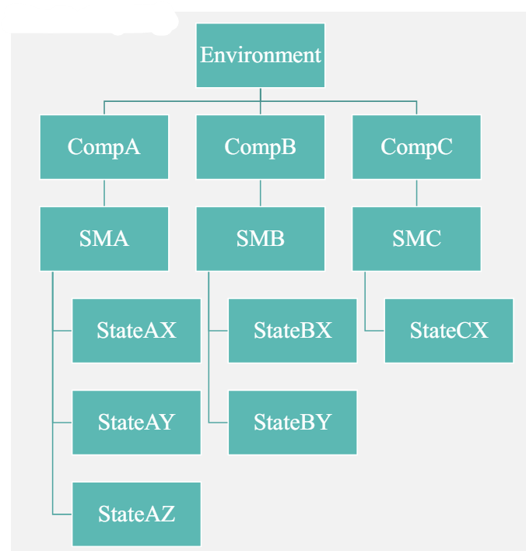
Solution

Slide 10
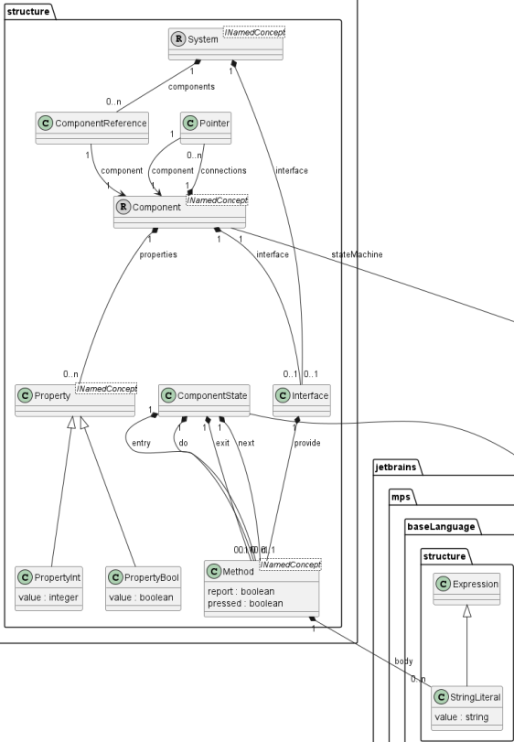
Solution: Components Language

Slide 11
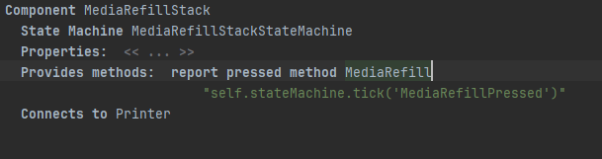
Solution: Components Language

Slide 12
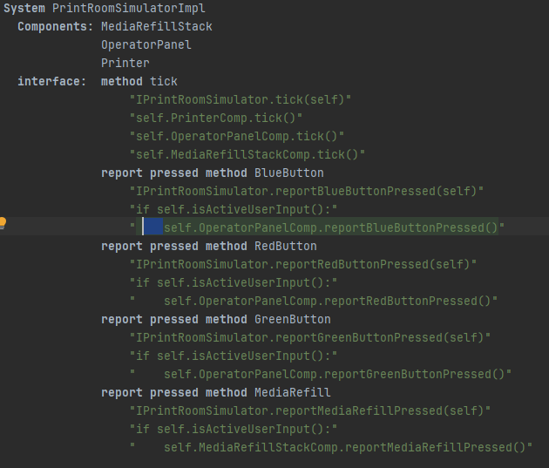
Solution: Components Language

Slide 13
Change Cases
Additional actions in operator panel (stopPrinting)
Additional behavior in printer (autoRefill)
Additional components

Slide 14


Design & Implementation Process

Slide 15


Slide 16
Experiences & Challenges
Keep:
Different level of understanding
Centralized repository
Try:
Think in your language’s terms

Slide 17
Thank you

